Slide 1
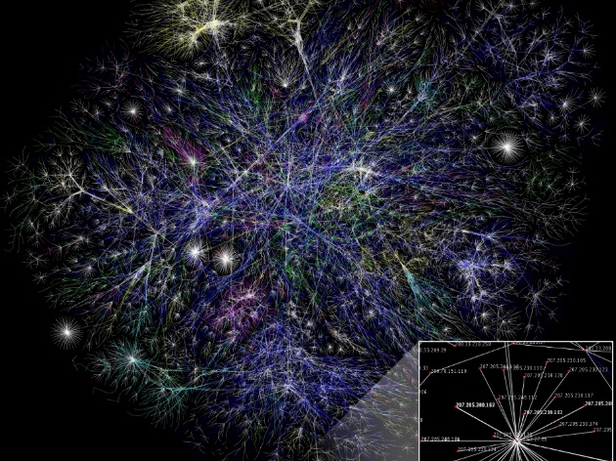
Optical Protection
Chapters 7: J. M. Simmons,
Optical Network Design and Planning, Optical Networks,
© Springer International Publishing 2014

Slide 2
Introduction
Failures are due to
fiber cuts, equipment failures, software errors,
technician errors, environmental causes, or
malicious attacks.
The optical protection mechanisms differ in the amount of spare capacity and equipment required, the speed of recovery, the number of concurrent failures from which recovery is possible, and the operational complexity.

Slide 3
Protection and Restoration in Internet, cont’d
The most likely failures are single failures rather than double failures.
Multiple failures may also be considered, but with proper design, the
probability of having multiple failures can be made very small.
A physical failure will lead to one or more links failing at the client layers.
Single-component failures, for example, transceiver failure, can lead to
single-link failures.
A fiber cut can lead to multiple link failures at the client layer if fibers
carry multiple wavelengths.
Links that fail together due to a single failure event are referred to as
shared risk link Groups (SRLGs).
Single switch or router failures also lead to SRLGs since all links incident
to the switch or router will fail.

Slide 4
Protection and Restoration in Internet, cont’d
Protection may be dedicated or shared.
In dedicated protection, each working connection is assigned its
own dedicated bandwidth in the network over which it can be
rerouted in case of a failure.
In shared protection, we make use of the fact that not all working
connections in the network fail simultaneously (for example, if they
are in different parts of the network).
An advantage of shared protection is that the protection bandwidth
is available to carry low-priority traffic under normal conditions.
This low-priority traffic is discarded in the event of a failure when
the bandwidth is needed to protect a connection.

Slide 5
Protection and Restoration in Internet, cont’d
Protection schemes can either be revertive or nonrevertive.
In both schemes, if a failure occurs, traffic is switched from the working
path to the protect path.
In a nonrevertive scheme, the traffic remains on the protect path until
it is manually switched back onto the original working path, usually by
a user through the network management system.
In a revertive scheme, once the working path is repaired, the traffic is
automatically switched back from the protect path onto the working
path.
Dedicated protection schemes may be revertive or nonrevertive;
however, shared protection schemes are usually revertive.

Slide 6
Dedicated Versus Shared Protection
One of the basic dichotomies among protection schemes is whether the protection is dedicated or shared
Dedicated Protection
1+1 dedicated protection
1:1 dedicated protection
non-revertive mode
revertive mode
Shared Protection

Slide 8
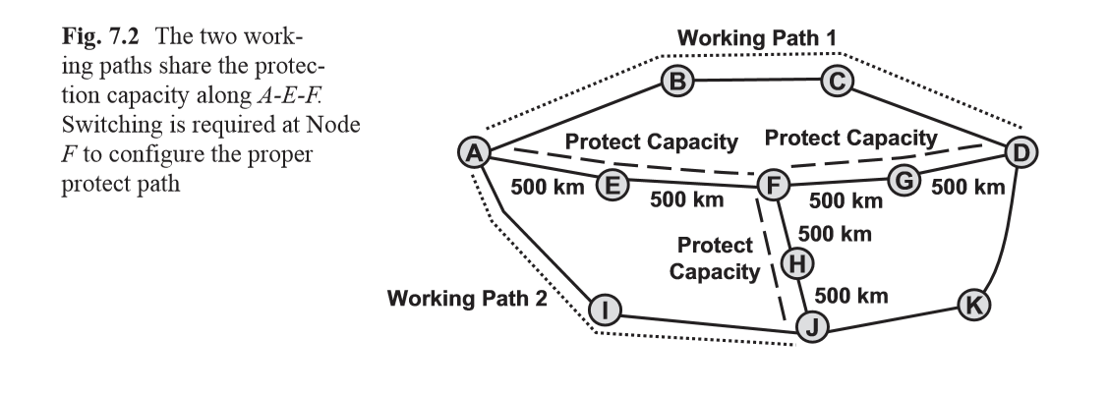

Slide 9

1+1 Protection
The 1+1 protected traffic is sent over two parallel paths,
and the destination selects a better one.
In case of failure, the destination switch onto the
other path.
Pros: simple for implementation and fast restoration
Cons: waste of bandwidth

Slide 10

1:1 Protection
During normal operation, no traffic or low priority traffic is
sent across the backup path.
In case failure both the source and destination switch onto
the protection path.
Pros: better network utilization.
Cons: required signaling overhead, slower restoration.

Slide 11
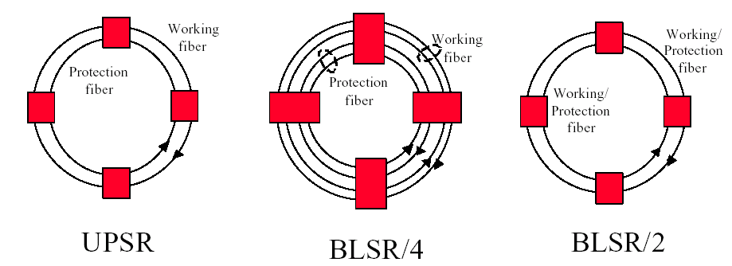
Protection in Ring Network
Unidirectional Path Switched Ring
Bidirectional Link Switched Ring
Bidirectional Link Switched Ring
1+1 Path Protection
Used in access rings for traffic aggregation into central office
1:1 Span and Link Protection
Used in metropolitan or
long-haul rings
1:1 Link Protection
Used for inter-office
rings

Slide 12
Unidirectional Path Switched Ring (UPSR)
Signal sent on both working
and protected path
Best quality signal selected
Receiving Traffic
Sending Traffic
N2
N1
Outside Ring = Working
Inside Ring = Protection
N3
N4
N1 send data to N2

Slide 13
Bidirectional Link Switched Ring (2-Fiber BLSRs)
Sending/Receiving
Traffic
Sending/Receiving
Traffic
N2
N1
Both Rings = Working & Protection
N3
N4

Slide 14
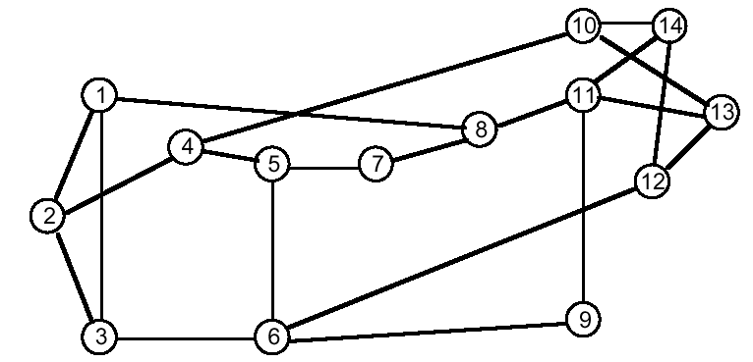
Protection in Mesh Networks
Network planning and survivability design
Disjoint path idea: service working route and its backup
route are topologically diverse
Working Path
Backup Path

Slide 15
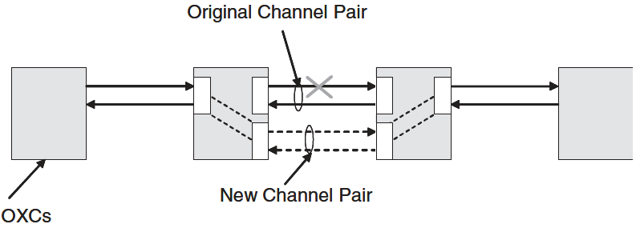
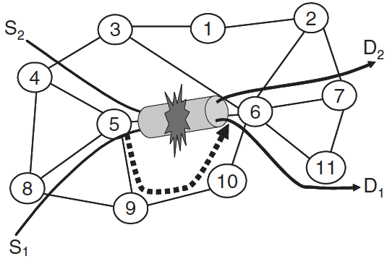
Path Protection / Link Protection
Link Switching: restoration is handled
by the nodes adjacent to the failure.
Span Protection: if additional fiber is
available.
Normal Operation
Path Switching: restoration is handled
by the source and the destination.

Slide 16
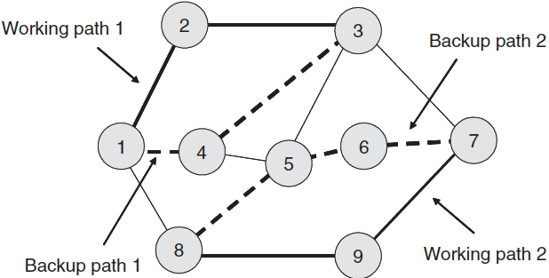
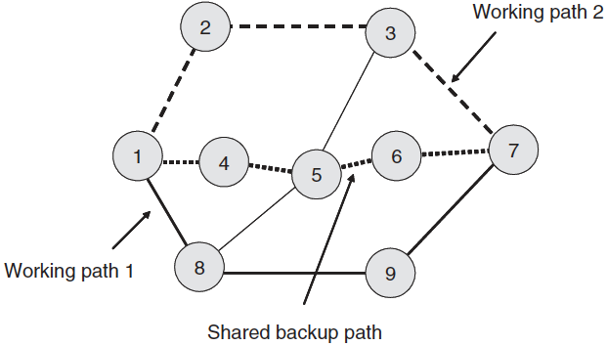
Path Protection
Dedicated Path Protection
Shared Path Protection
Backup resources are used for protection of multiple links
The capacity reserved for protection is greatly reduced in the shared protection

Slide 17
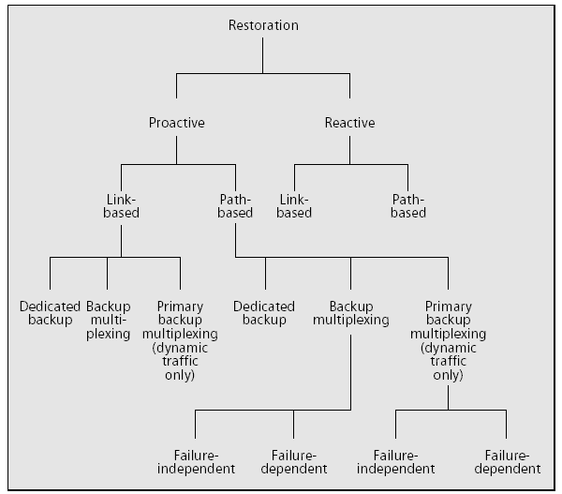
Reactive / Proactive
Reactive
A search is initiated to find a
new lightpath which does not
use the failed components
after the failure happens.
It can not guarantee
successful recovery,
Longer restoration time
Proactive
Backup lightpaths are
identified and resources are
reserved at the time of
establishing the primary
lightpath itself.
100 percent restoration
Faster recovery
Taxonomy

Slide 18
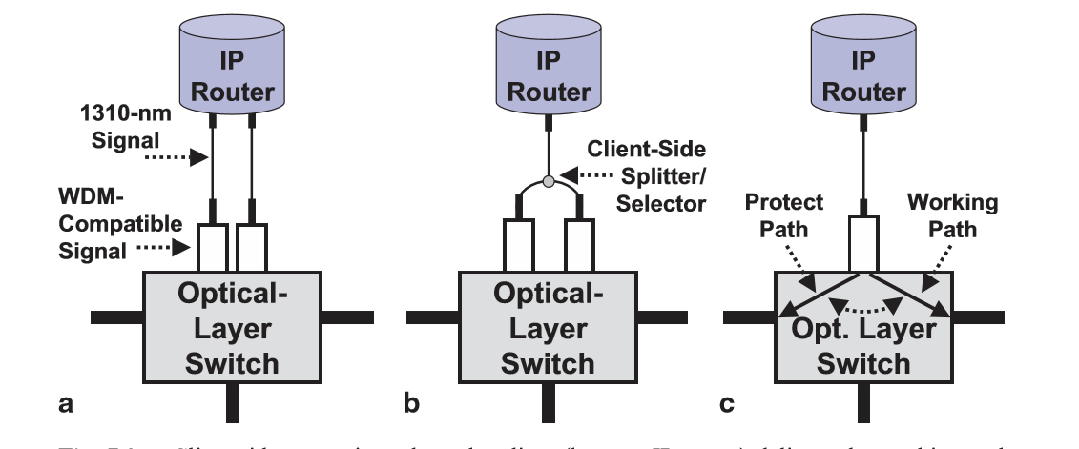
Client-Side Versus Network-Side Protection

Slide 19
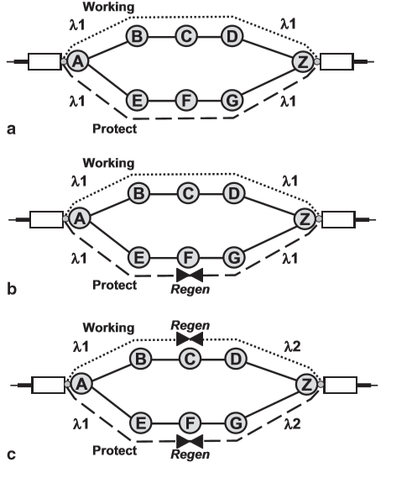
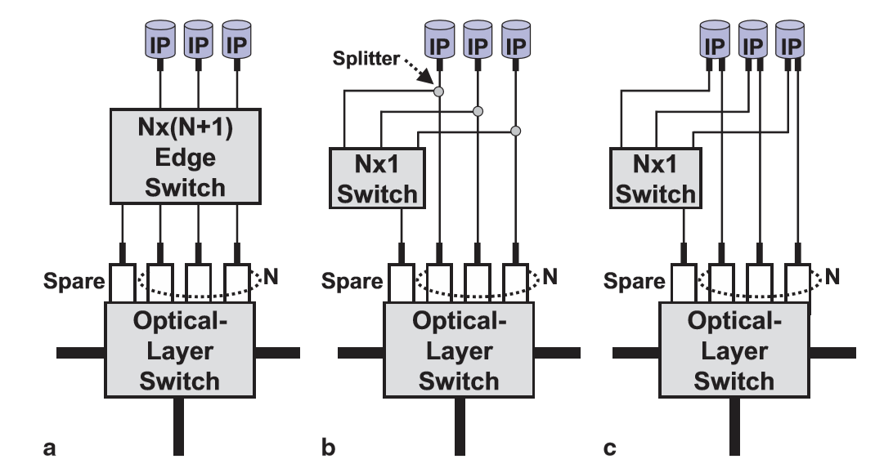
Protection type
Transponder Protection
Wavelength Assignment with Network-Side Protection
1:N

Slide 20
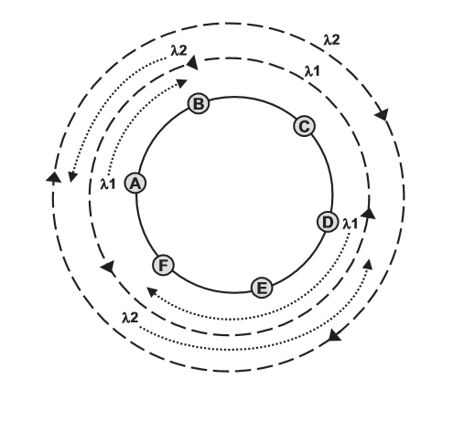
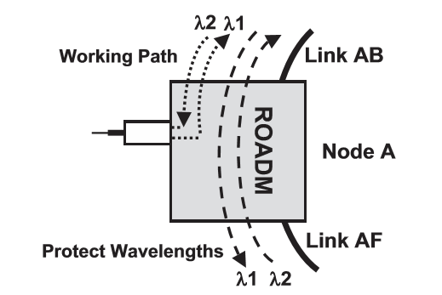
Ring Protection Versus Mesh Protection
Ring Protection
Details of Node A
Network-side shared ring protection

Slide 21
Optical Multiplex Section Shared Protection Ring (OMS-SPRing) protection
E-F-A-B E-F-E-D-C-B-A-B
Shared optical ring protection after Link EF fails

Slide 22
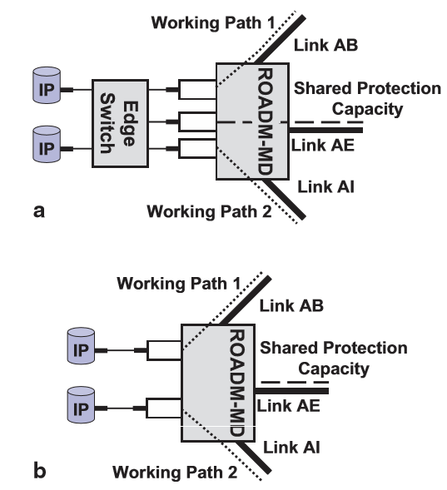
Mesh Protection

Slide 23
Fault-Dependent Versus Fault-Independent Protection
In fault-dependent schemes, the protection used depends on where the failure has occurred
In fault-independent schemes, the same protection mechanism is used regardless of the fault location
Link Protection
Path Protection
Segment Protection

Slide 24
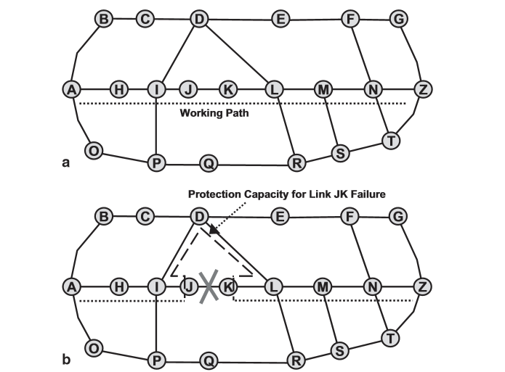
Link Protection

Slide 25
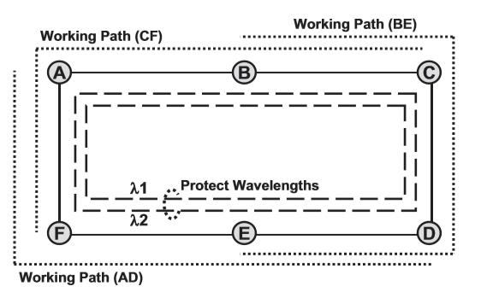
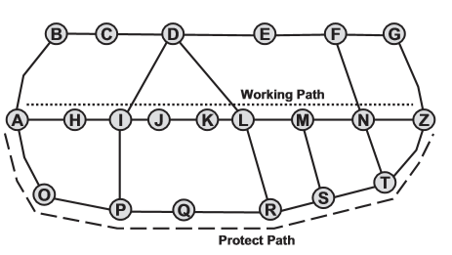
Path Protection
At the other extreme is fault-independent path protection.

Slide 26
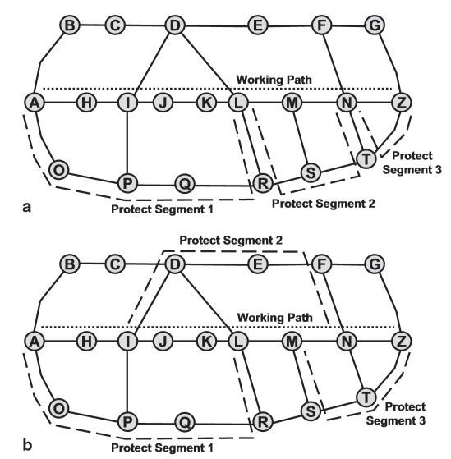
Segment Protection

Slide 27
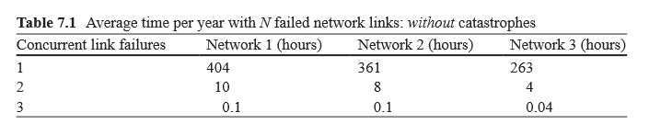
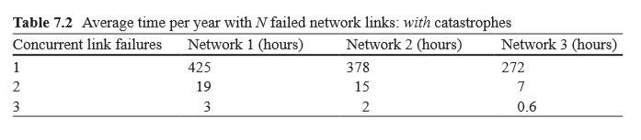
Multiple Concurrent Failures
Multiple Concurrent Failures: Without Catastrophes
The most common cause of a link failure is a fiber cut or an amplifier failure
Multiple Concurrent Failures: With Catastrophes
Catastrophes can be modeled as correlated link failures

Slide 28
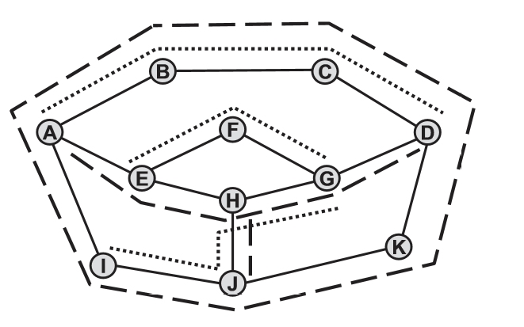
Protection Schemes for Multiple Concurrent Failures
1 + 2 Dedicated Protection
1 + 1(+ 1) Protection
1 + 1 + Shared Protection
Shared Protection
working paths : dotted lines
shared protection : dashed lines

Slide 29
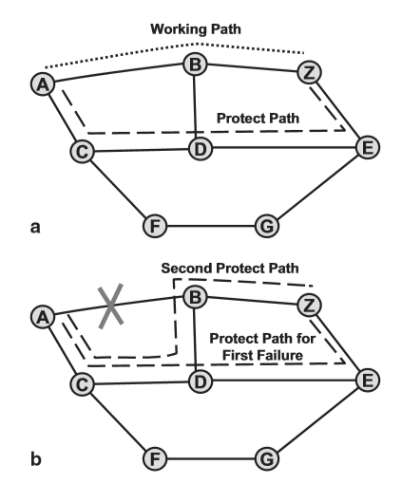
Protection through Dynamic Networking
If the second failure is on Link CD, then path A-C-F-G-E-Z is established for recovery

Slide 30
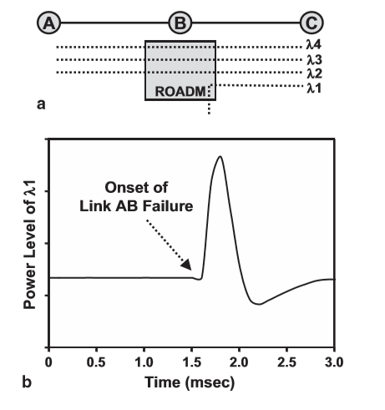
Effect of Optical Amplifier Transients on Protection

Slide 31
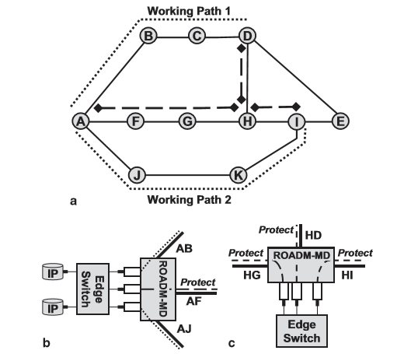
Shared Protection Based on Pre-deployed Subconnections
a= Shared protection based on pre-deployed
subconnections
b= Details of Node A
c= Details of Node H

Slide 32
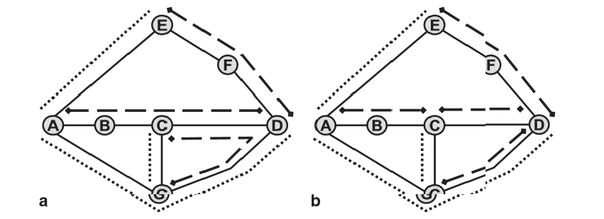
Cost Versus Spare Capacity Trade-off
a Three pre-deployed subconnections, requiring seven wavelength-links of capacity and six transponders.
b Four pre-deployed subconnections, requiring six wavelength-links of capacity and eight transponders

Slide 33
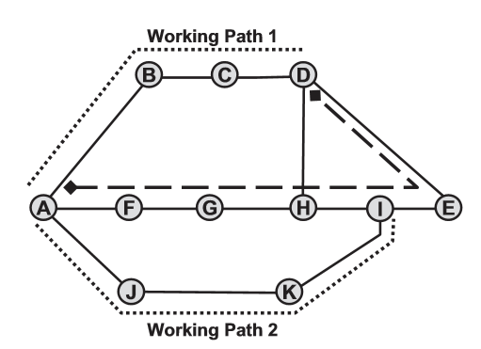
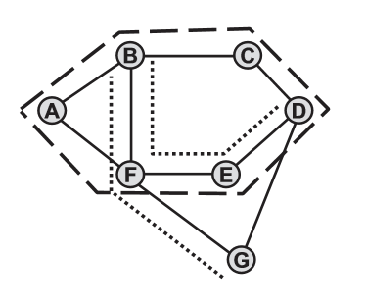
Shared Protection Based on Pre-Cross-Connected Bandwidth
P-Cycles
If E-F breaks in A-F-E-D, new path is B-F-A-B-C-D-E-D.
Pre-cross-connected Trails

Slide 34
Quiz
Consider a 3×6 grid network, where each link is 1,000 km in length and the optical reach is 3,000 km.
(a) Partition this network into the fewest number of transparent islands.
(More than one solution is possible.) Assume that all inter-island traffic is regenerated at a border node. Assuming one wavelength of bidirectional traffic between each pair of nodes, how many regenerations are required in your design?
(b) With the same traffic, what is the minimum number of regenerations required in a selective-regeneration architecture?

